Slide 1


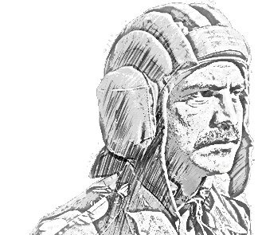
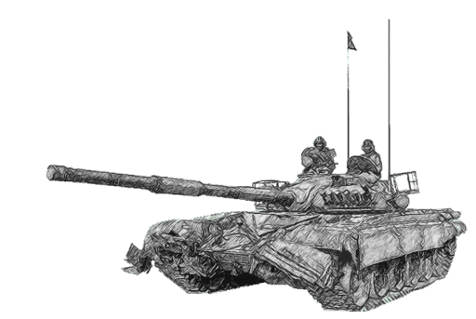
SCHOOL OF TECH TRG
ELECTRONICS WING
Notes:
.

Slide 2
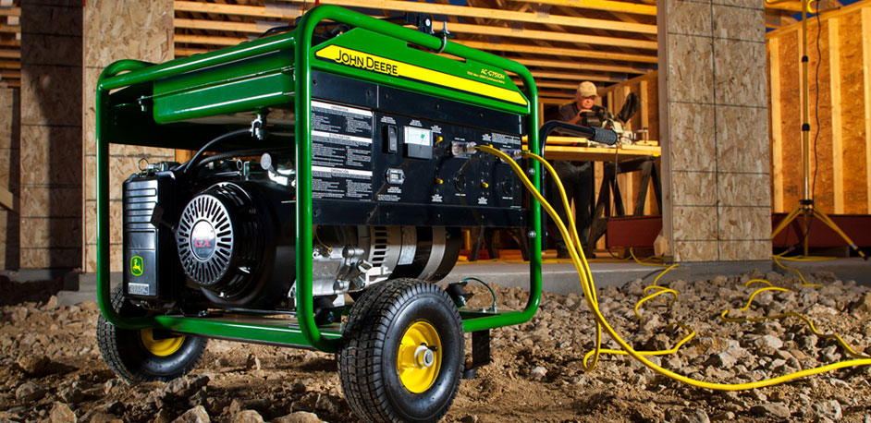
AC GENERATOR

Slide 3
AC GENERATOR
PART NO – I INTRODUCTION
PART NO– II CONSTRUCTION
PART NO– III WORKING
(a) 0⁰ TO 90⁰
(b) 90⁰ TO 180⁰
(c) 180⁰ TO 270⁰
(d) 270⁰ TO 360⁰
(e) FREQUENCY OF AC
PART NO 1 : AC GENERATOR
(a) AAM BAYAN
(b) ASUL
(c) BANAWAT
(d) WORKING
(i) 0⁰ TO 90⁰
(ii) 90⁰ TO 180⁰
(iii) 180⁰ TO 270⁰
(iv) 270⁰ TO 360⁰
(e) FREQUENCY OF AC

Slide 4
AC GENERATOR
PART NO – IV DIFFERENT TYPES OF GENERATOR
(a) TYPES OF GENERATOR
(i) SINGLE PHASE GENERATOR
(ii) TWO PHASE GENERATOR
(iii) THREE PHASE GENERATOR
(b) PHASE LOAD DISTRIBUTION
(c) FACTOR EFFECTING OUTPUT.
(d) DIFFERENTS BETWEEN SINGE PHASE AND THREE PHASE GENERATOR

Slide 5
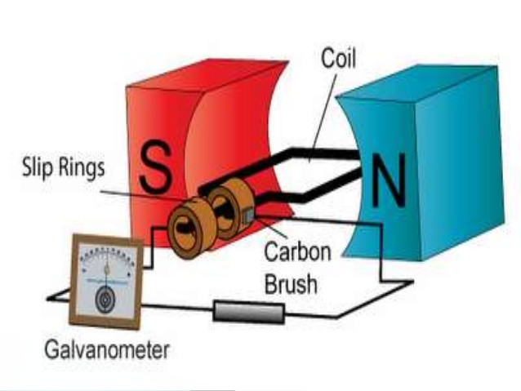
INTRODUCTION

Slide 6
INTRODUCTION
To operate various kinds of electrical equipment energy is required.
In case of low power eqpt btys can be used but for high power reqmt ac mains is used & where it is not available, generators are used. Electricity can be produced by a variety of methods.

Slide 7
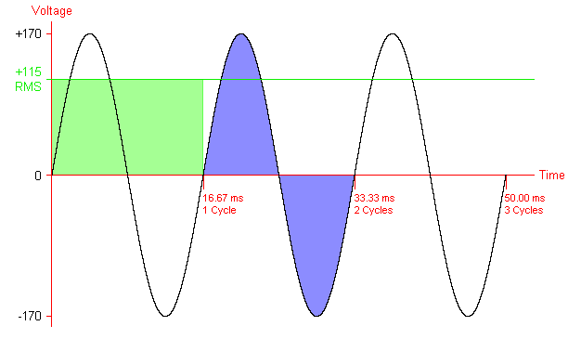
AC CURRENT

Slide 8
GENERATOR

Slide 9
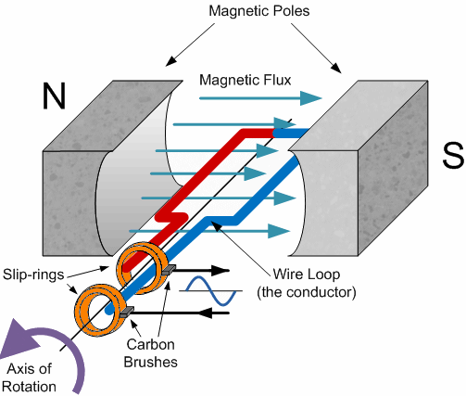
AC GENERATOR

Slide 10
PRINCIPLE
The working of a generator is based on the principle of electromagnetic induction, which states that when a conductor is moved in a magnetic field ,an emf is induced in it.
In generators mechanical energy is provided for moving the conductors in the magnetic field, so as to produce electrical energy.

Slide 11
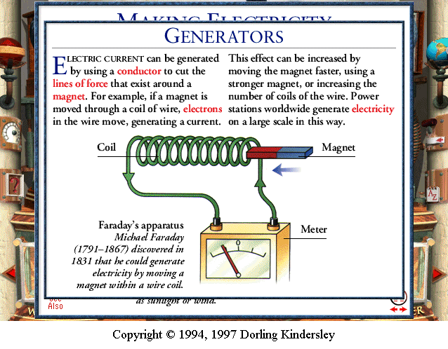
PRINCIPLE

Slide 12
PART NO II CONSTRUCTION

Slide 13
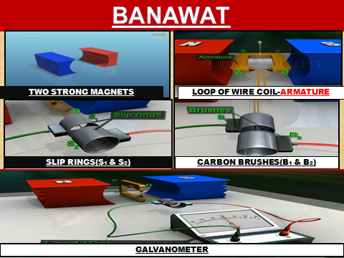
CONSTRUCTION

Slide 14

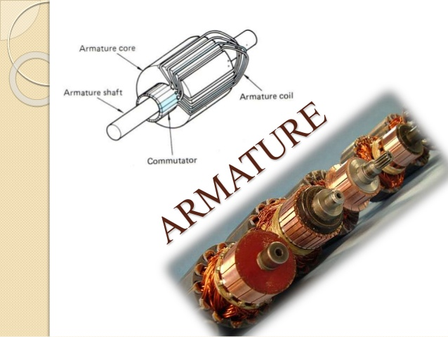
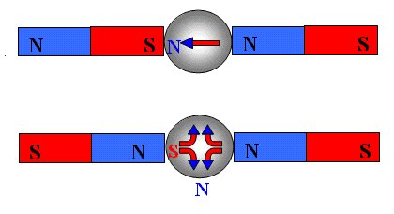
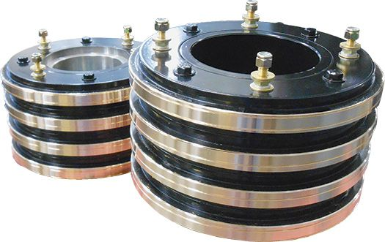
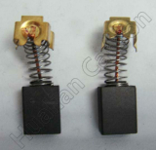
CONSTRUCTION
Slip Ring
Carbon Bushes

Slide 15
PART NO III WORKING

Slide 16
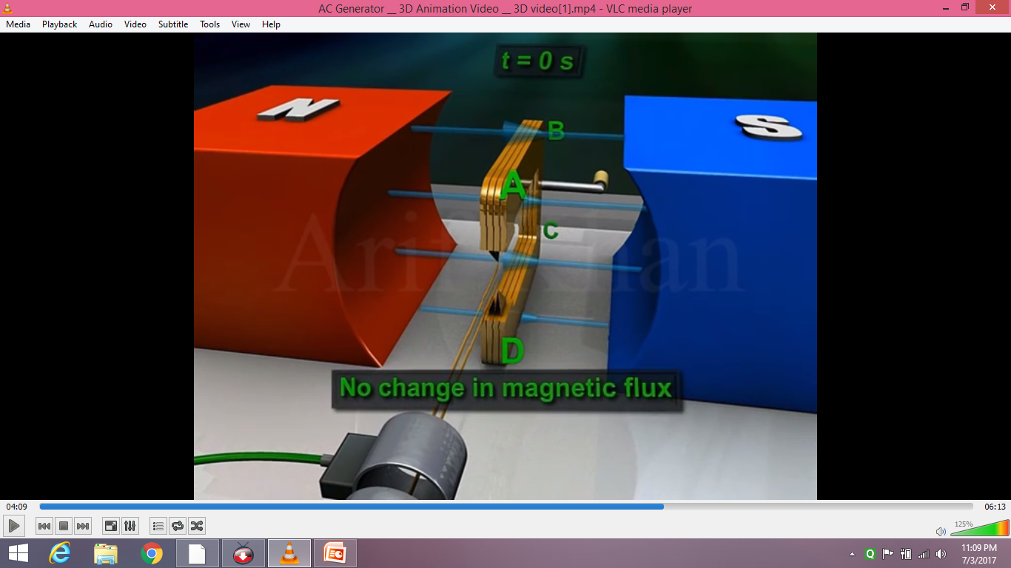
MOVEMENT FROM 0⁰ TO 90⁰
B1
S1
S2
B2

Slide 17
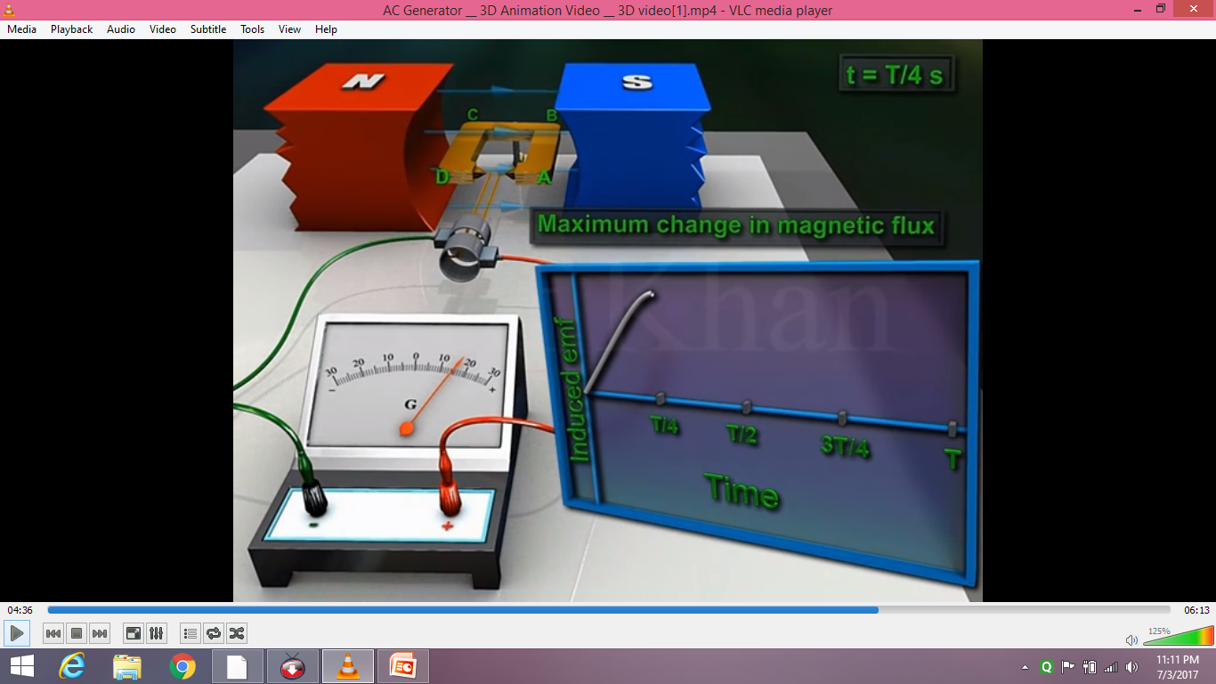
MOVEMENT FROM 0⁰ TO 90⁰

Slide 18
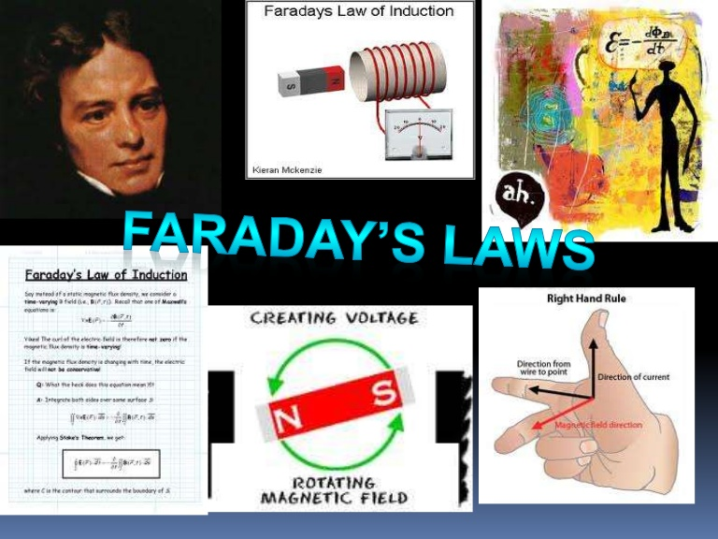
E = LxAxN d II
dt
L= Length of conductor.
A = Area of conductor.
N = Number of turns.
d II = Rate of change
dt of flux

Slide 19
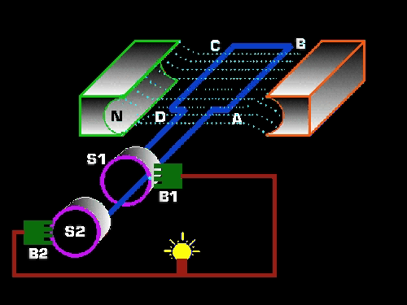
0⁰ TO 90⁰

Slide 20
MOVEMENT FROM 90⁰ TO 180⁰
B1
S1
S2
B2

Slide 21
90⁰ TO 180⁰

Slide 22
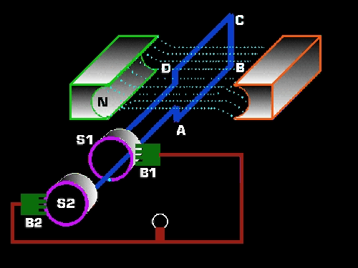
90⁰ TO 180⁰

Slide 23
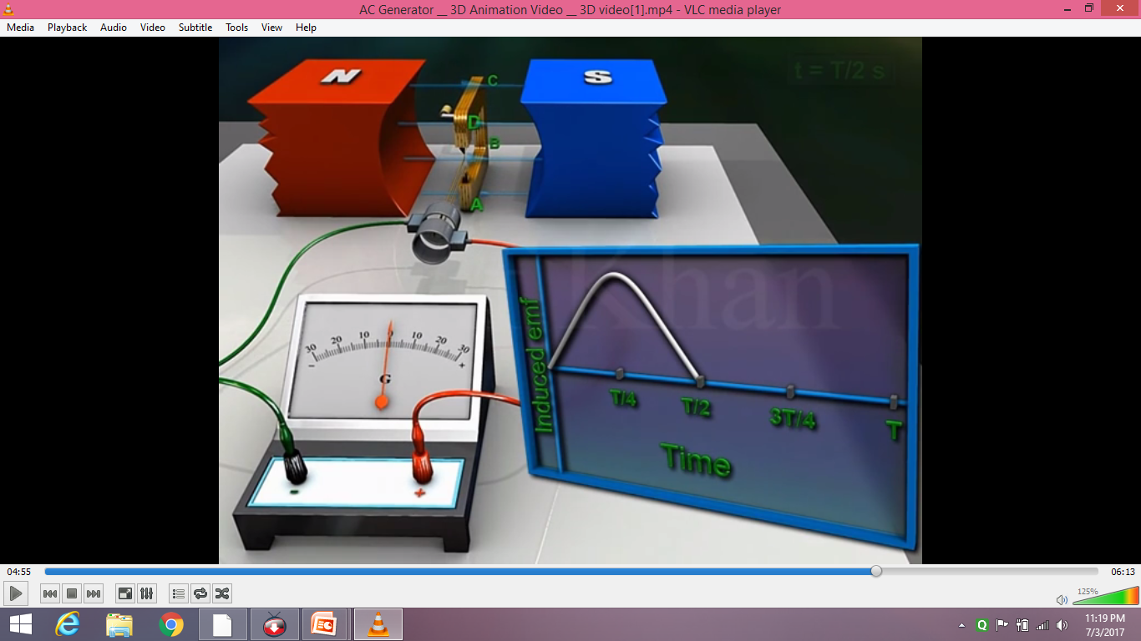
MOVEMENT FROM 90⁰ TO 180⁰

Slide 24
180⁰ TO 270⁰

Slide 25
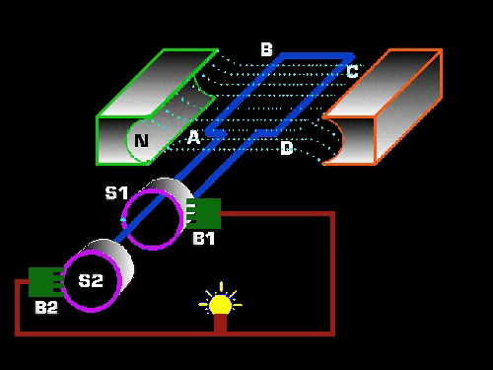
180⁰ TO 270⁰

Slide 26
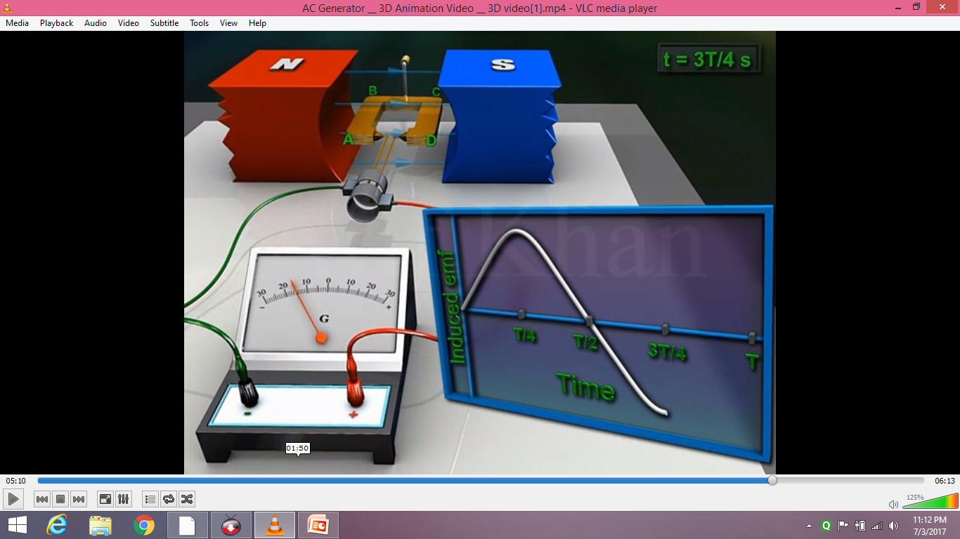
MOVEMENT FROM 180⁰ TO 270⁰

Slide 27
270⁰ TO 360⁰

Slide 28
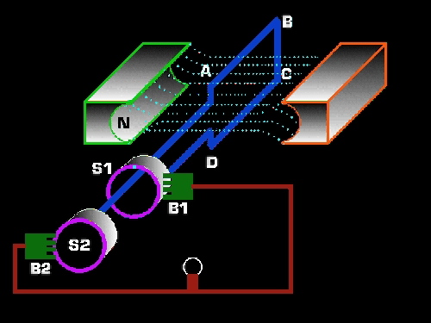
270⁰ TO 360⁰

Slide 29
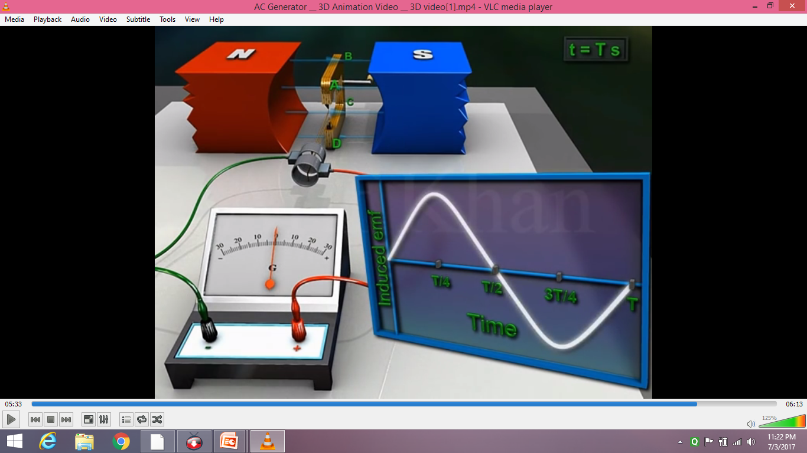
MOVEMENT FROM 270⁰ TO 360⁰

Slide 30
FREQUENCY OF AC
As the conductor makes one rotation the current completes one cycle of ‘ac’
The freq of ac is the no of cycle the conductor completes in one sec
Increase in no of poles increases the freq

Slide 31
FREQUENCY OF AC

Slide 32
Part No. 4 DIFFERENT TYPES OF GENERATOR

Slide 33
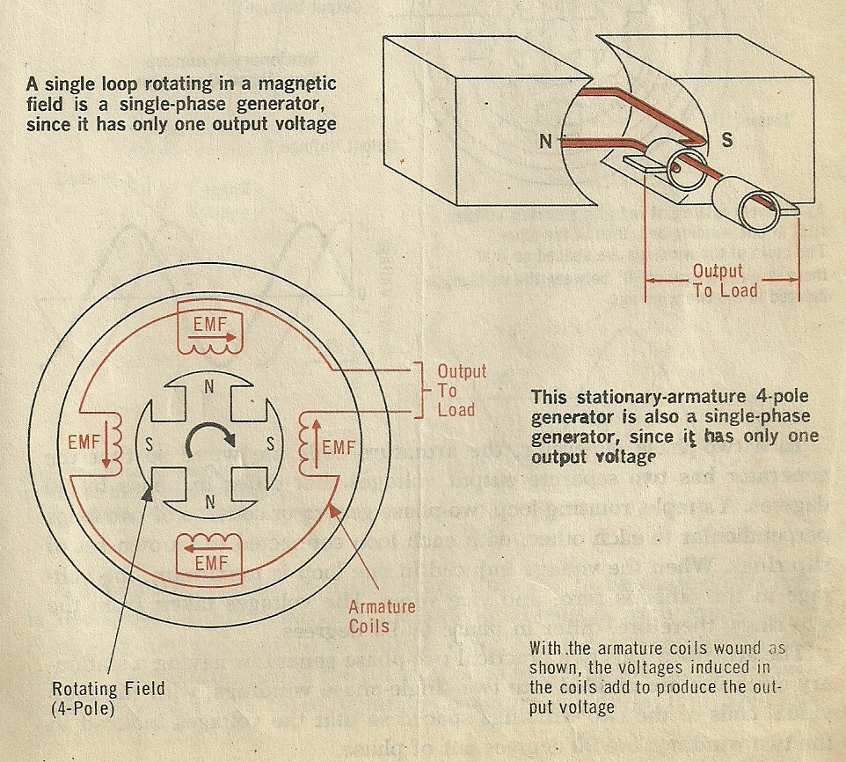
SINGLE PHASE GENERATOR

Slide 34
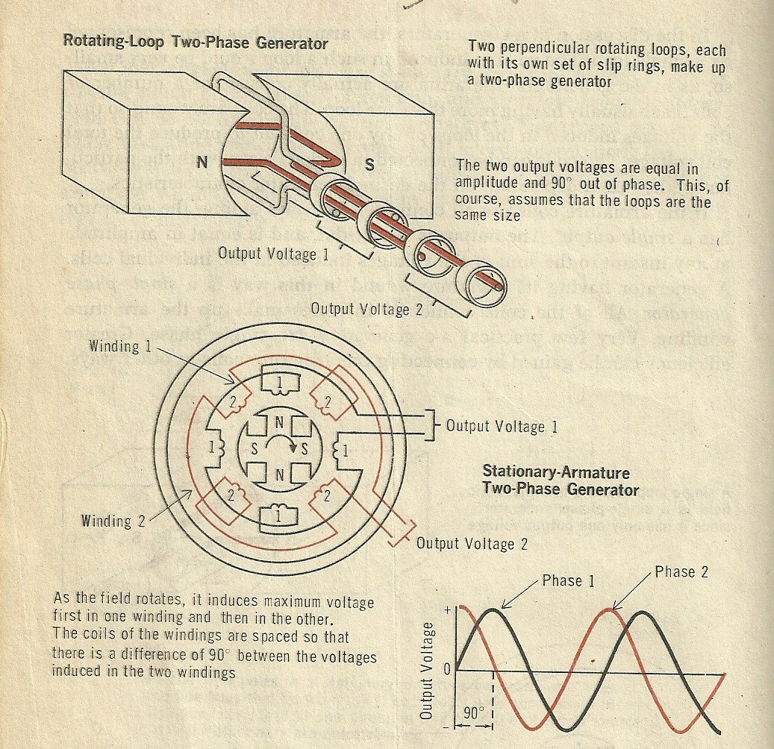
TWO PHASE GENERATOR

Slide 35
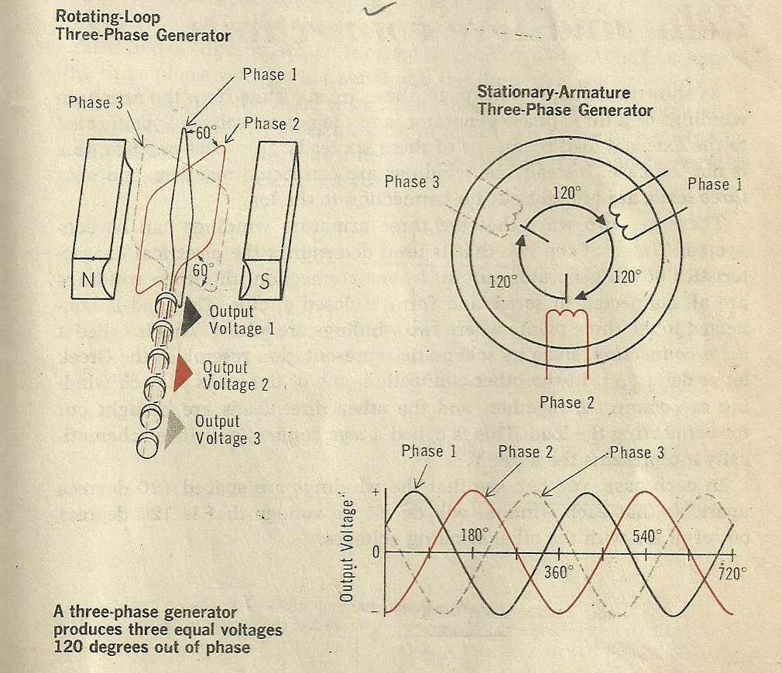
THREE PHASE GENERATOR

Slide 36
FACTOR EFFECTING OUTPUT
SHAPE OF CONDUCTOR.
MOV OF CONDUCTOR.
STRENGTH OF MAGNETIC FIELD.
NO OF COILS.

Slide 37
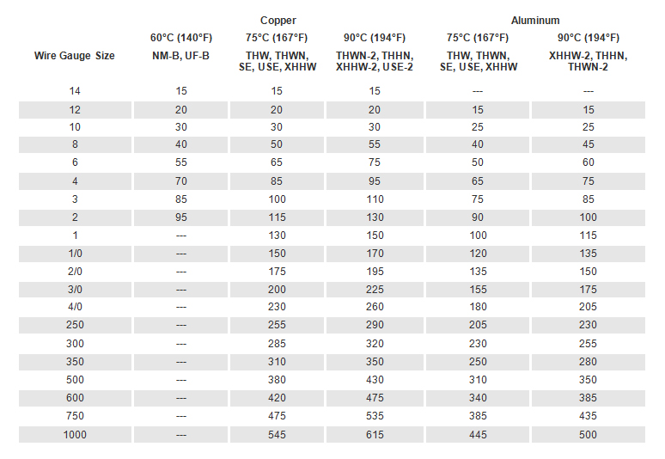
AMPERE WIRE GUAGE

Slide 38


Slide 39
AC GENERATOR

Slide 40
AC GENERATOR
BHAG NO – I INTRODUCTION
(a) AAMBAYAN
(b) AC CURRENT
(c) GENERATOR
(d) AC GENERATOR
(e) ASUL
(f) ELECTRO MAGNETIC INDUCTION
BHAG NO – II BANAWAT
BHAG NO – III WORKING
(a) 0⁰ TO 90⁰
(b) 90⁰ TO 180⁰
(c) 180⁰ TO 270⁰
(d) 270⁰ TO 360⁰
(e) FREQUENCY OF AC
PART NO 1 : AC GENERATOR
(a) AAM BAYAN
(b) ASUL
(c) BANAWAT
(d) WORKING
(i) 0⁰ TO 90⁰
(ii) 90⁰ TO 180⁰
(iii) 180⁰ TO 270⁰
(iv) 270⁰ TO 360⁰
(e) FREQUENCY OF AC

Slide 41
AC GENERATOR
PART NO – IV DIFFERENT TYPES OF GENERATOR
(a) TYPES OF GENERATOR
(i) SINGLE PHASE
(ii) TWO PHASE
(iii) THREE PHASE GENERATOR
(b) PHASE LOAD DISTRIBUTION
(c) FACTOR EFFECTING OUTPUT.
(d) DIFFERENTS BETWEEN SINGE AND DOUBLE PHASE GENERATOR

Slide 42
DC GENERATOR

Slide 43


